Slide 1
remote sensing ecological indicators for environmental monitoring
Margarita Huesca Martinez

Slide 2

Presentation overview
Learning objectives
Introduction
Ecosystem Characteristics and Spectral Properties
Remote Sensing Variables for Environmental Monitoring
Applications
Conclusions

Slide 3

Learning objectives
To analyze ecosystem characteristics based on spectral properties
To search remote sensing variable to monitor environmental processes
To select the most appropriate remote sensing variable to monitor environmental processes

Slide 4
Introduction
To understand the basis of remote sensing
Types of data that remote sensing techniques can generate
Ecological variables that can be estimated by remote sensing
The use of remote sensing data in time to monitor the earth

Slide 5

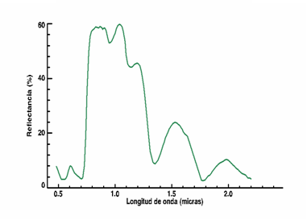
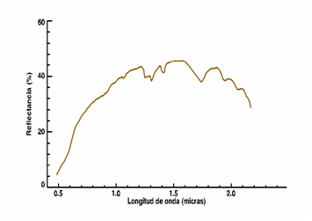
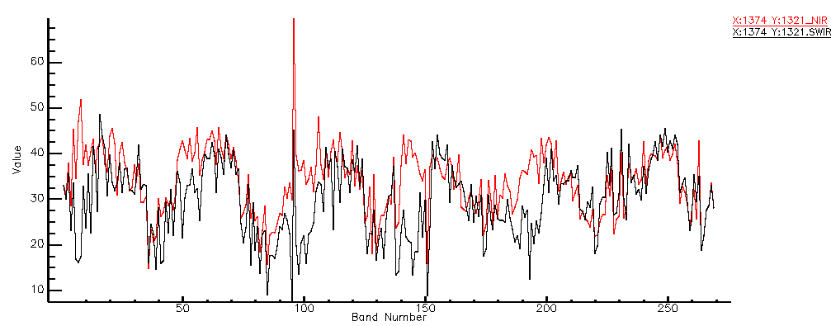
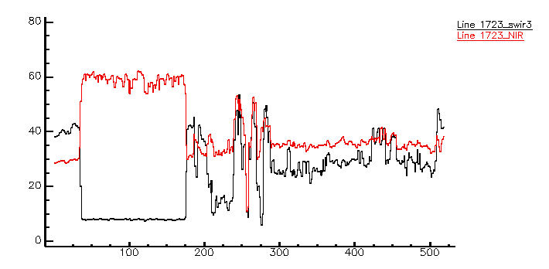
Introduction: Data Characteristics
Wavelength
Wavelength (microns)
Space
Time (months)
Distance (m)

Slide 6
Ecosystem Characteristics & Spectral Properties
Ecosystem
Functional properties
Structural properties
Spectral properties
Temporal evolution acquired by remote sensors

Slide 7
Remote Sensing Variables for
Environmental Monitoring
Spectral band | Spectral metrics | Biophysical variables from models
Blue Green Red NIR SWIR TIR | Vegetation indices Albedo Absorption features | Leaf Area Index Surface cover Gross Primary Productivity Net Primary Productivity Evapotranspiration Vegetation moisture Rainfall use efficiency

Slide 8
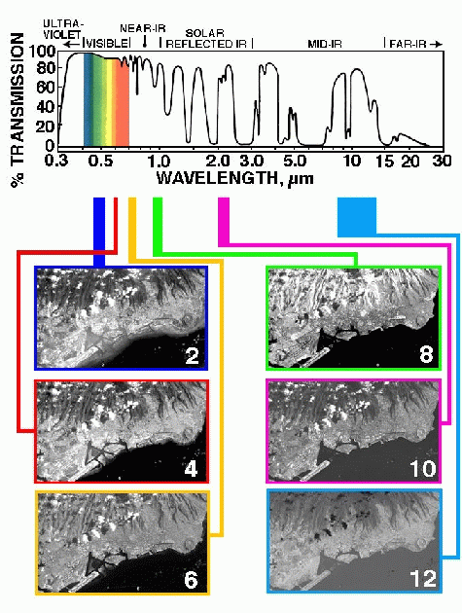
Spectral Bands: Multispectral Sensors
One image for each wavelength
DN value of pixels at each band depend on reflectance at that specific wavelength

Slide 9
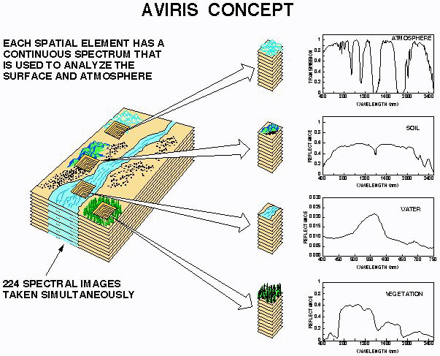
Spectral Bands: Hyperspectral Sensors
Hyperspectral sensors measure reflectance at many wavelengths

Slide 10
Spectral Metrics: Vegetation Indices
NDVI in Cabañeros National Park
XEROPHITIC FOREST
Year | Aridity index
2000 | 28,94
2001 | 36,02
2002 | 24,92
2003 | 21,54
2004 | 18,82
2005 | 9,06
2006 | 14,49
GRASSLANDS
Aridity index: PA / TA
Where: PA [mm] Annual accumulated rainfall
TA [CºMonthly average temperature.

Slide 11
Biophysical Variables from Models

Slide 12
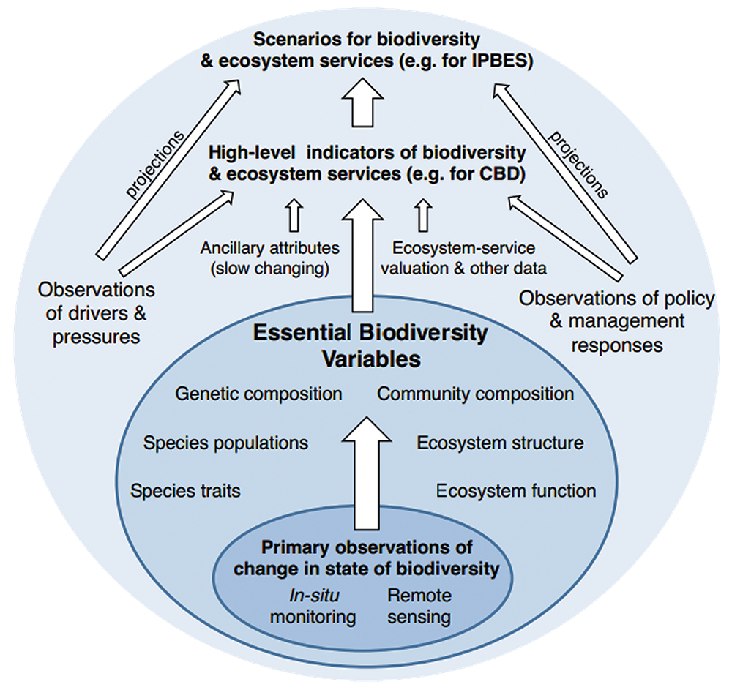
Essential Variables for Environmental Monitoring
Essential Climate Variables
Essential Biodiversity Variables
Essential Water Variables
https://geobon.org/ebvs/what-are-ebvs/

Slide 13
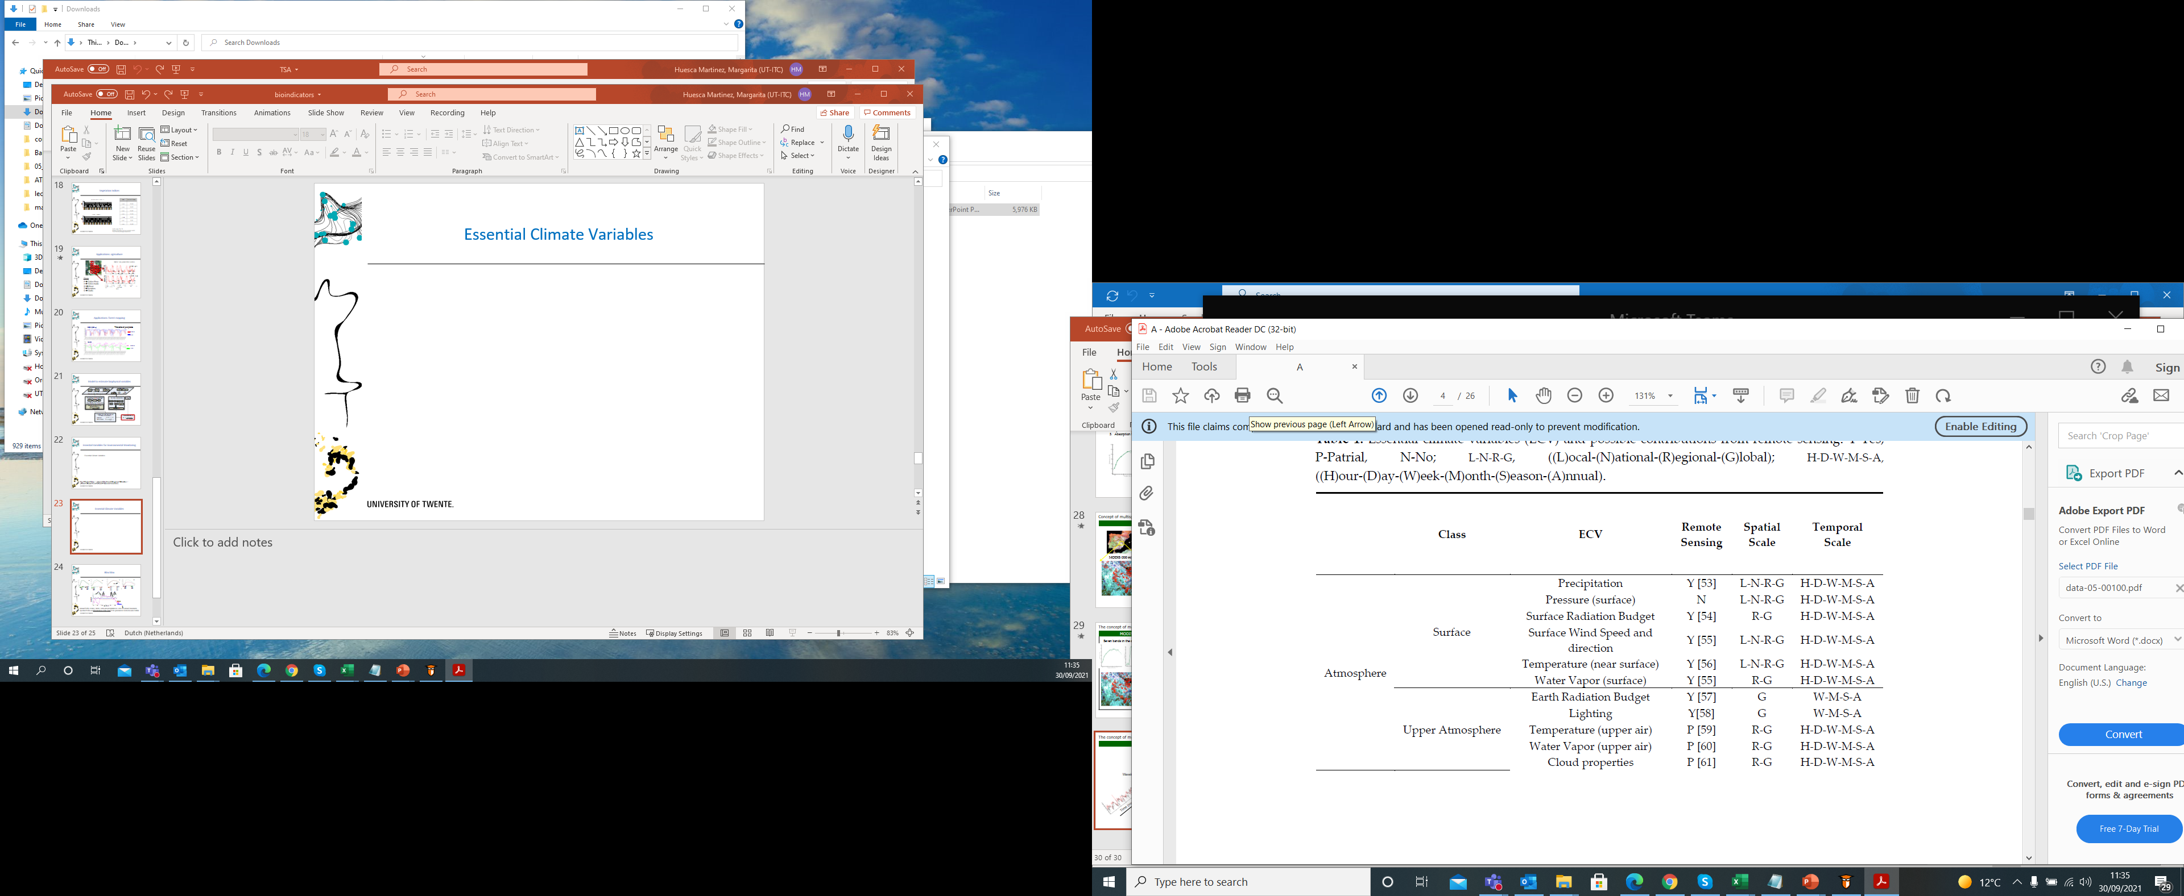
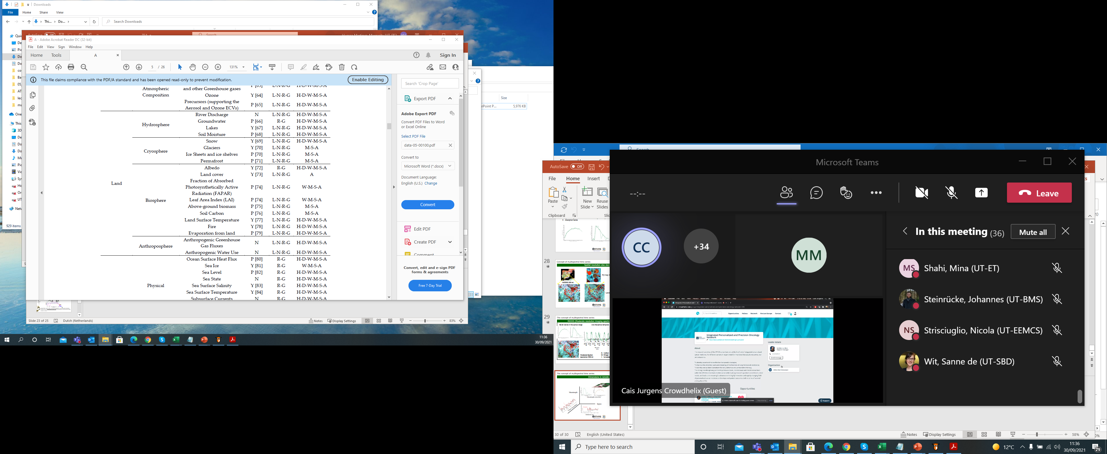
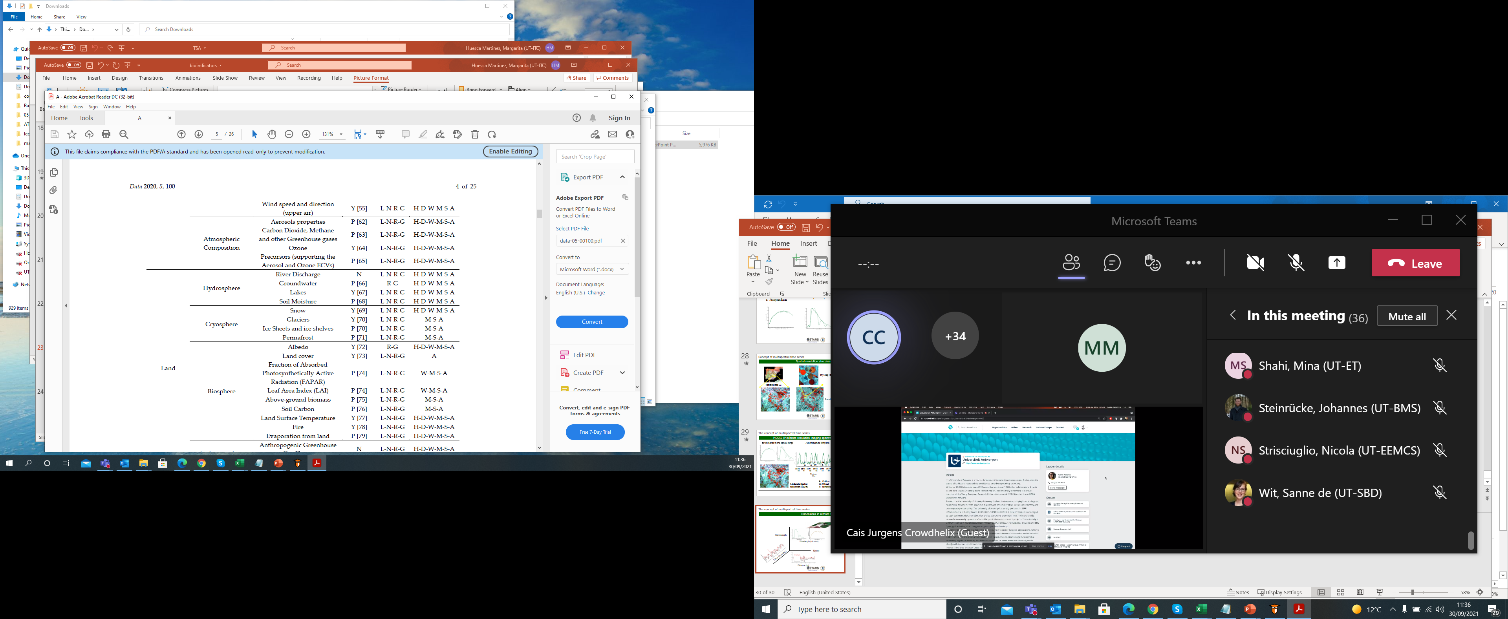
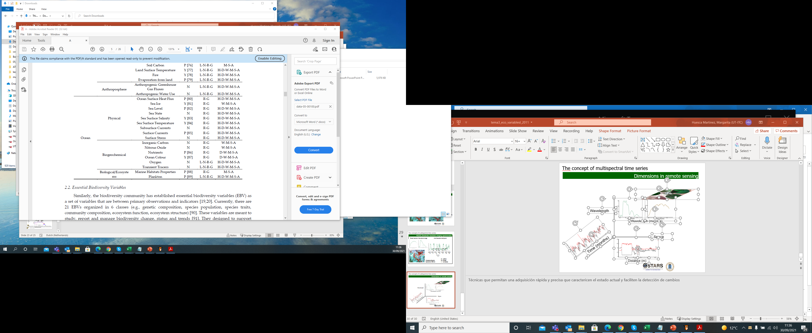
Essential Climate Variables
(Y)es-(P)atrial-(N)o. /
((L)ocal-(N)ational-(R)egional-(G)lobal)
((H)our-(D)ay-(W)eek-(M)onth-(S)eason-(A)nnual)

Slide 14
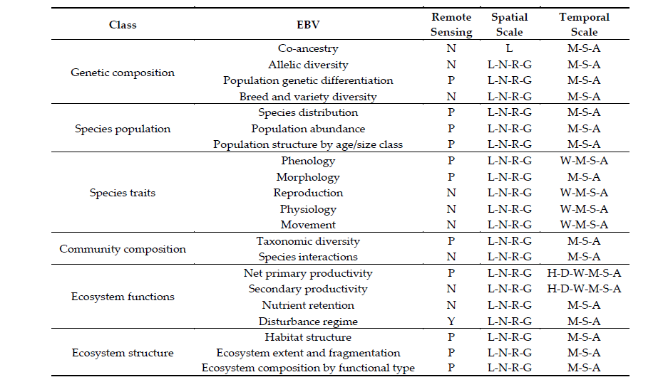
Essential Biodiversity Variables
(Y)es-(P)artial-(N)o. /
((L)ocal-(N)ational-(R)egional-(G)lobal)
((H)our-(D)ay-(W)eek-(M)onth-(S)eason-(A)nnual)

Slide 15
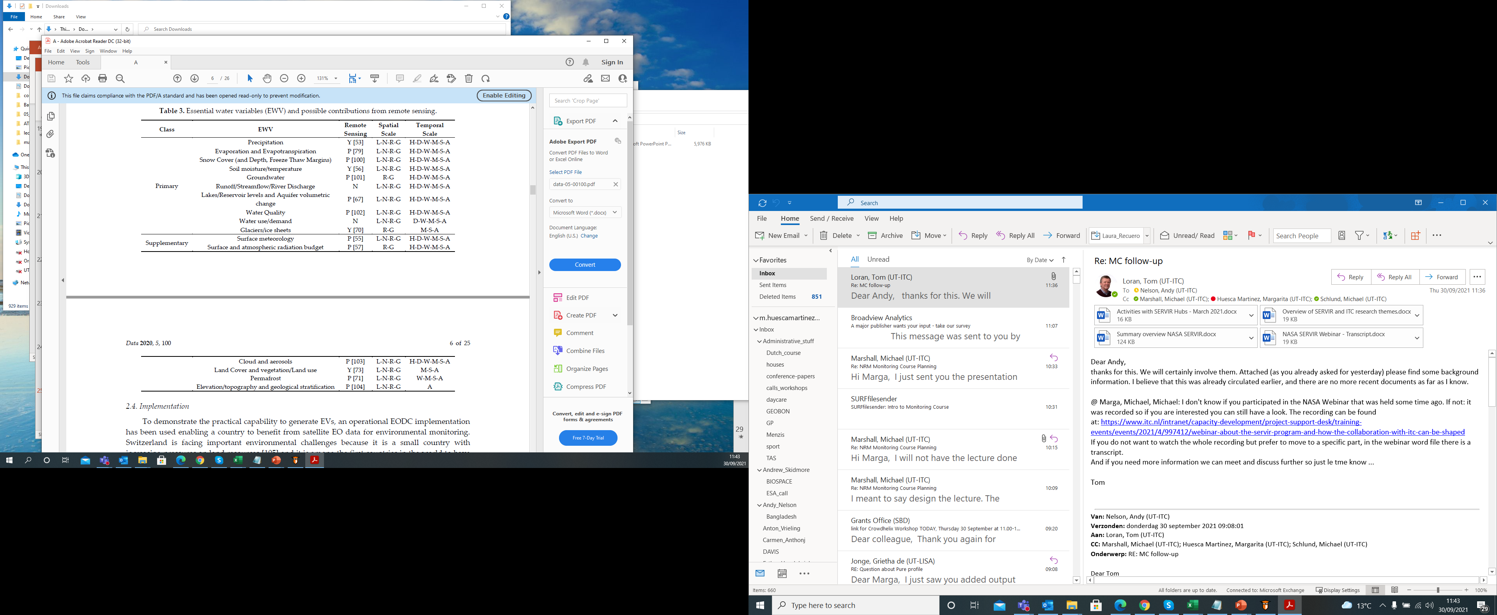
Essential Water Variables
(Y)es-(P)atrial-(N)o. /
((L)ocal-(N)ational-(R)egional-(G)lobal)
((H)our-(D)ay-(W)eek-(M)onth-(S)eason-(A)nnual)

Slide 16

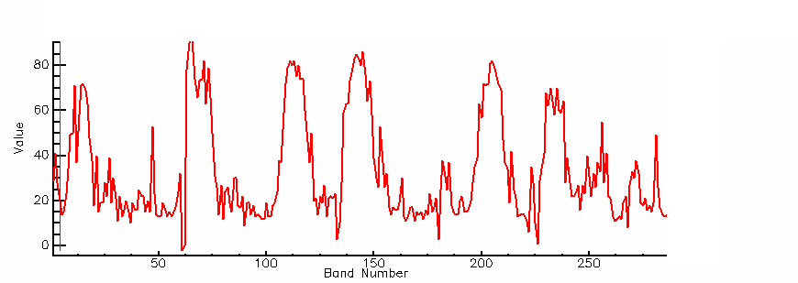
Applications: Agriculture
30
NDVI: six years time series
30
-
-
1
1
31
31
-
-
1
1
30
Field 4-1
30
-
-
4
4
30
30
-
-
3
3
32
32
-
-
4
4
32
32
-
-
3
3
6
6
-
-
1
1
6
6
-
-
2
2
5
5
-
-
1
1
5
5
-
-
2
2
4
4
-
-
1
1
NDVI (%)
6
6
-
-
4
4
6
01 02 03 04 05
A A W A W
6
-
-
3
3
4
4
-
-
2
5
2
5
-
-
4
4
5
5
-
-
3
3
8
8
-
-
1
7
1
7
-
-
1
1
7
7
-
-
2
2
8
8
-
-
2
2
Field 6-4
Crops
P → Cotton Pima
A → Cotton Acala
W →Wheat
T →Tomatoes
G → Garlic
NDVI (%)
01 02 03 04 05
A A W A T
26/02 22/03 23/04 25/05 25/06 28/07 26/06
00 01 02 03 04 05 06
Día/mes Año

Slide 17
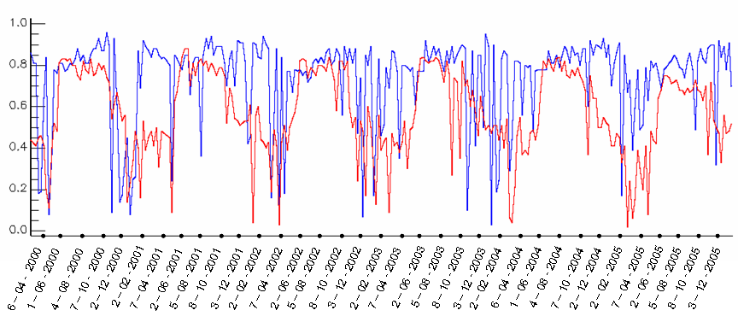
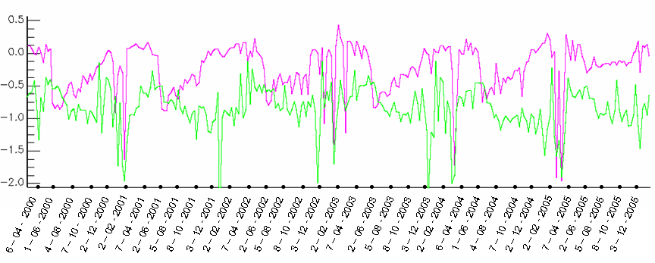
Applications: Forest Mapping
NDVI (500 m)
Time series of pure pixeles
Rebollo
Pino
SANI
Rebollo
Pino

Slide 18
Conclusions
The spectral, spatial and temporal resolution of remote sensing data allow to monitor the earth
The temporal resolution of remote sensing data allows you to analyze and monitor a process in the past as well as in remote locations
Remote sensing metrics can be used as proxy of essential variables for environmental monitoring
The time series derived from remote sensing data provide information about dynamic patterns

Slide 19
thank you!!
Margarita Huesca Martinez

